Slide 1

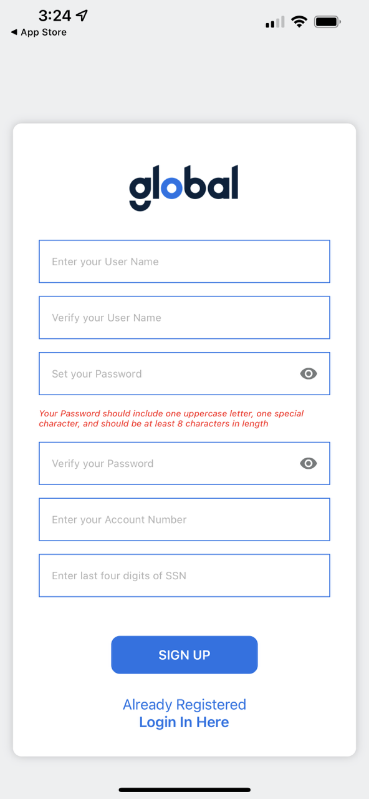
Global Holdings Mobile App!
Reviewed 2/7/2024
Available in both the Apple App Store (for iOS) and Google Play Store (for Android)
Requires Global Account ID# to set up secure access
Account balance access, transaction monitoring and statement downloads
Suitable replacement for Attorney Model clients with no portal
Multi-factor Authentication required
  Clients are required to input their existing password and a unique verification code, sent via text or email, when accessing the Global Mobile App.
Notes:
Enrollments were down to $61MM in December from $81MM in November
Internal (non-affiliate) enrollments of $46MM were 23% below forecast ($60MM)
Drivers include macro factors: holiday seasonality, covid increases, stimulus allowing customers to put off decisions
Internally we are observing it is harder to reach customers, lower P2 rates, and lower close rates

